Slide 1
Surviving the Titanic
Jason Chow

Slide 2
Splitting the Data
We are given data with 891 observations
This data is split into a training set and a test set with a 75/25 split
Training set has 668 observations, test set has 223 observations
df = pd.read_csv("train.csv")
df_train, df_test = train_test_split(df, test_size=0.25, random_state=123)

Slide 3
EDA
We explore the data to gain insights about how to clean the data and what information can be extracted from the data
Initial inspection of the data using:
df_train.info()

Slide 4
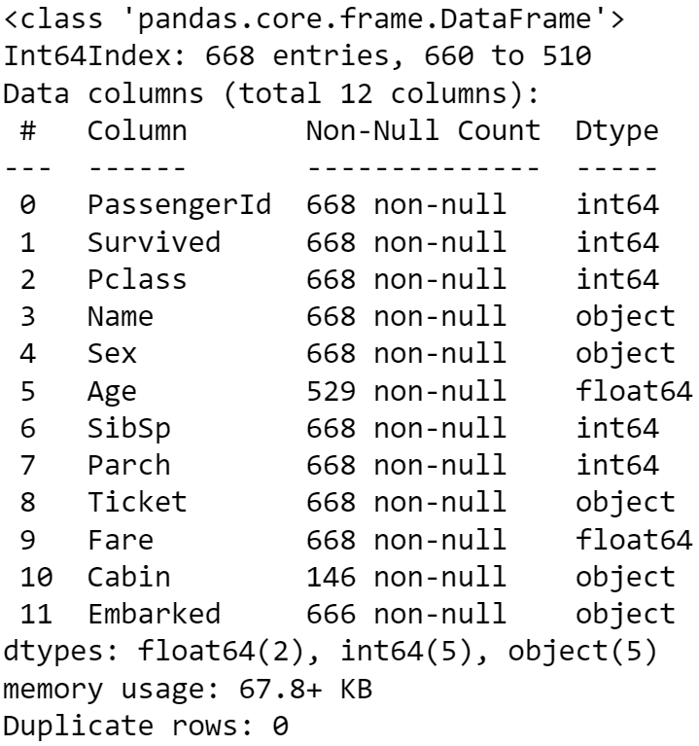
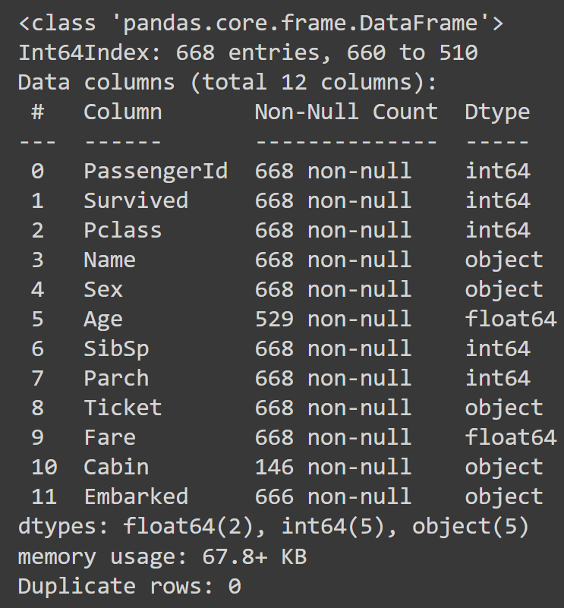
Observations:
Over 75% of entries are missing the “Cabin” feature
Around 20% of entries are missing the “Age” feature
2 entries are missing the “Embarked” feature
Cabin column will be dropped
Missing values in the age and embarked columns will be imputed by regression and mode, respectively

Slide 5
Initial Data Wrangling
The “PassengerId” and “Cabin” features are dropped
“PassengerId” provides no new insights about the data
“Cabin” column in dropped as there are too many missing entries
Values in the “Sex” feature are encoded
Values of 0 correspond to males
Values of 1 correspond to females
Missing values in the “Embarked” feature are imputed with the mode

Slide 6
Socio-Economic Status
A new feature “Family” is created for the number of family members a given passenger has on board, excluding themselves
df_train["SibSp"] + df_train["Parch"]
Using the groupby method, we find relationships between the ticket class and the other features
df_train.groupby("Pclass").mean()
These relationships were also plotted

Slide 7
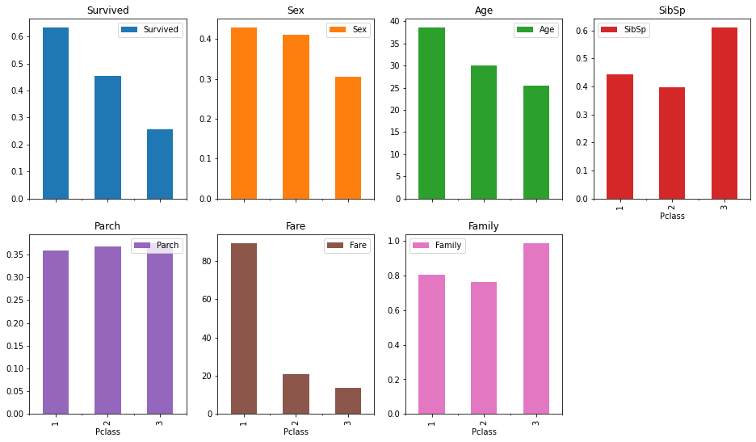
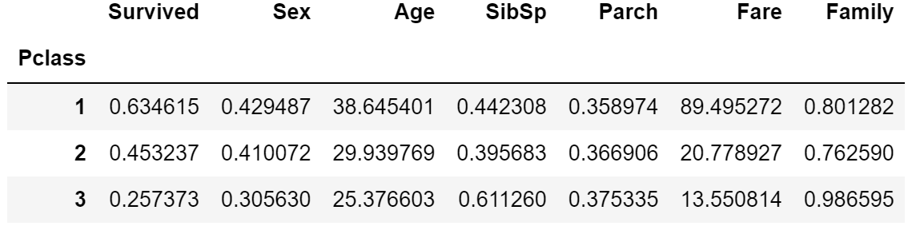

Slide 8
Observations
As expected, the fare decreases as ticket class increases
Assumption that poorer families would most likely prefer buying tickets of lower classes
This is why ticket class was used as a measure of socio-economic status
Those of a lower economic status tend to have:
Much lower survival rates
More family members on board
Tend to be younger
Tend to be males

Slide 9
Survival Analysis
Using the groupby method, we find relationships between survival and the other features
df_train.groupby("Survived").mean()
These relationships were also plotted

Slide 10
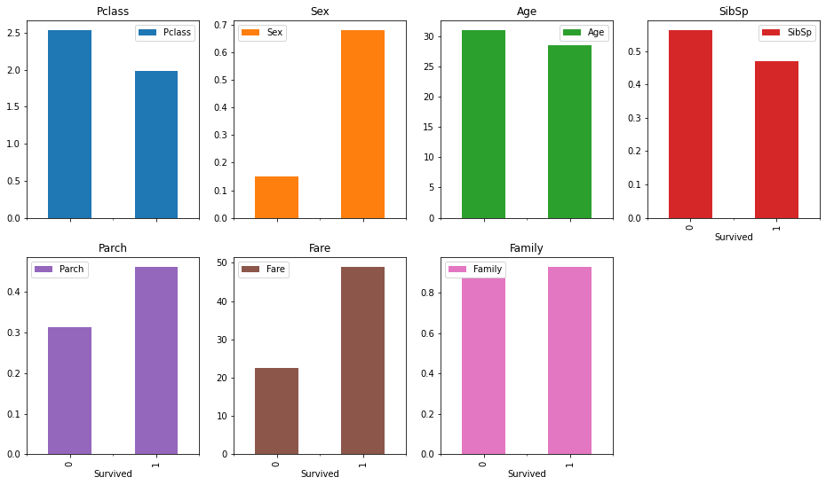
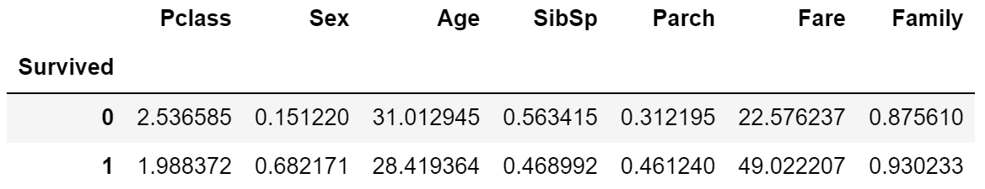

Slide 11
Observations
Those who survived tended:
To have paid a higher fare and are part of a higher ticket class
To be female
To have parents/children on board
To be younger
These observations make sense:
Those who have paid a higher fare were probably treated better/prioritized during the sinking
Those who are younger are most likely more mobile and can get to safety much more effectively

Slide 12
Sex Analysis
The large disparity in survival between males and females warrants an investigation
Once again using the groupby method, we find relationships between sex and the other features

Slide 13
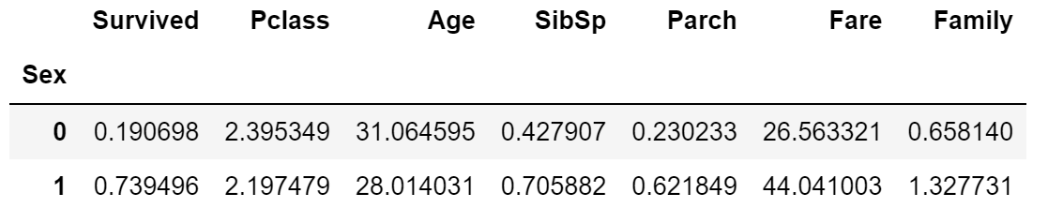
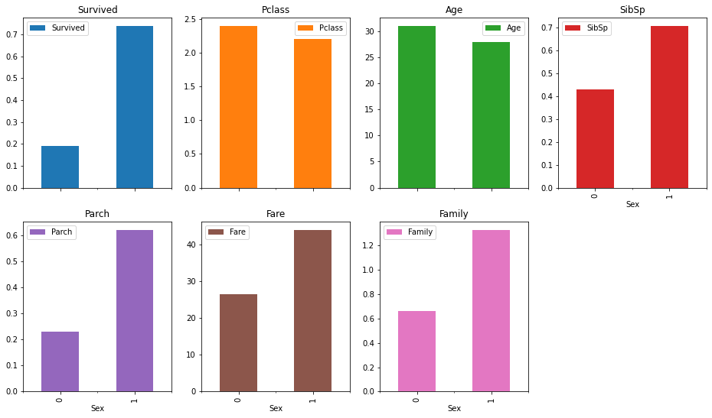
(Male)
(Female)

Slide 14
Observations
The trends are consistent with the trends observed before with the other features
Females tended to:
Have a higher socio-economic status
Are younger
Have more family members on board
All three of those tendencies correlate with having a higher survival rate
This shows that there is some collinearity between the features, since the features are in some way related to each other

Slide 15
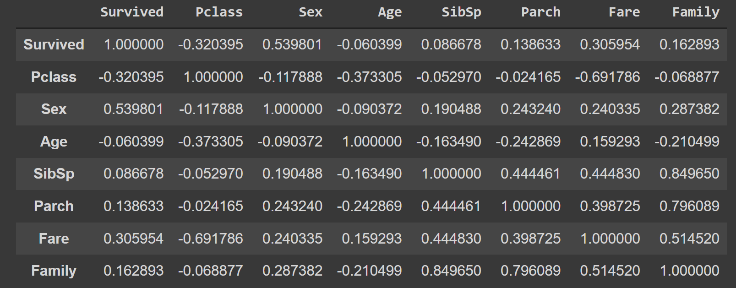
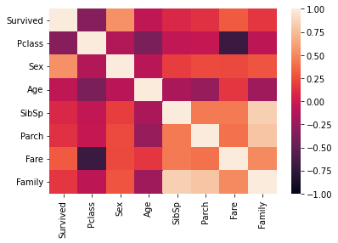
Correlation Matrix
A correlation matrix was created to help determine important features
A heatmap was also created to visualize the correlation matrix

Slide 16
Observations
Significant correlation with survival between ticket class, sex, and fare
Weaker correlation between survival and number of family members on board
Barely any correlation with survival between number of parents/children aboard, age, and number of siblings/spouses on board

Slide 17
Final Data Wrangling
Categorical features were dropped to prepare the dataset for modeling
“Name”, “Ticket”, and “Embarked” columns
Features relating to the number of siblings/spouses and number of children/parents are dropped due to the creation of the family feature
Family feature was derived from a linear combination of the two dropped features
The same was done to the test set

Slide 18
Missing Value Imputation of “Age”
The missing values were imputed using a decision tree regressor based on the values of other features
contains_age = df_train[df_train.Age.notnull()]
missing_age = df_train[df_train.Age.isnull()]
imp = IterativeImputer(estimator=DecisionTreeRegressor(), random_state=123).fit(contains_age)
missing_age = imp.transform(missing_age)

Slide 19
Feature Scaling
The features were scaled so optimization algorithms can converge quicker
Algorithms like KNN would also perform better when features are scaled and normalized
scaler = StandardScaler().fit(df_train_X)
feature_names = scaler.get_feature_names_out()
df_train_X = pd.DataFrame(scaler.transform(df_train_X), columns=feature_names)
df_test_X = pd.DataFrame(scaler.transform(df_test_X), columns=feature_names)

Slide 20
Modeling and Question Answering
3 models were created to predict whether a given passenger would survive based on select features
Features used: Pclass, Sex, Age, Fare, and Family
The performance of each model was evaluated using metrics such as
Accuracy
Precision
Recall
F score

Slide 21
1. Regularized Logistic Regression
Logistic regression: A classification algorithm – a method to find the best decision boundary between two classes
Regularized: Technique used to keep coefficients small by penalizing large coefficients
Addresses the issue of overfitting
Results:
Accuracy: 79.4%
Precision: 74.4%
Recall: 69.0%
F-Score: 71.6%

Slide 22
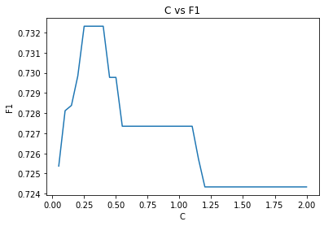
1a. Regularized Logistic Regression with CV
Using 10-fold stratified K-fold cross validation, the value of C in the logistic regression model was optimized
C: inverse of the regularization term (λ)
Stratified K-fold CV: splits the data into folds that preserve the percentage of samples for each class
An optimal value of C that was found was 0.3
Using that, the results are as follows:
Accuracy: 79.4%
Precision: 74.4%
Recall: 69.0%
F-Score: 71.6%
Same results as logistic regression without using cross validation

Slide 23
2. K-Nearest Neighbors
An observation is classified by its similarity to other observations nearby – i.e., the observation is classified by the most common class among its k nearest neighbors
Results:
Accuracy: 86.1%
Precision: 84.4%
Recall: 77.4%
F-Score: 80.7%

Slide 24
2a. K-Nearest Neighbors with Cross Validation
The value of K (in KNN model) was optimized using 10-fold stratified K-fold cross validation
The optimal value of K was found to be:
2 or 4 when optimizing for accuracy
3 or 5 when optimizing for f score
Results:
Accuracy: 80.7% (K=2); 86.1% (K=5)
Precision: 82.5% (K=2); 84.4% (K=5)
Recall: 61.9% (K=2); 77.4% (K=5)
F-Score: 70.7% (K=2); 80.7% (K=5)
KNN with K=2 performed worst than regular KNN without CV. KNN with K=5 performed the same (K=5 is the default value).

Slide 25
3. Multilayer Perceptron
Perceptron: takes a weighted sum of the inputs, applies a function to the weighted sum, and returns an output
There are multiple layers of perceptrons, hence the name.
Input layer, hidden layer, output layer
Results:
Accuracy: 83.9%
Precision: 80.0%
Recall: 76.2%
F-Score: 78.0%

Slide 26
3a. Multilayer Perceptron with CV
The values of alpha (regularization term) and the number of neurons in the first hidden layer were optimized using 10-fold stratified K-fold cross validation
Optimal value for alpha: 0.012367
Optimal number of neurons for the first hidden layer: 7
Results:
Accuracy: 85.2%
Precision: 81.5%
Recall: 78.6%
F-Score: 80.0%
Performed a bit better than the MLP model without CV on all metrics

Slide 27
Observations
Out of the three models, the regularized logistic regression model performed the worst in all metrics
The MLP algorithm performed the next best in all metrics
The best performing algorithm based on all metrics is K-nearest neighbors
Using cross validation techniques for parameter tuning, the logistic regression and KNN models didn’t perform differently
Using CV on the MLP model increased its performance on all metrics by a few percentage points each

